Slide 1
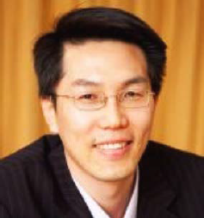

2026 G-MOT Invited Talk
PARK YOUNGWON
3월 24일 (화) , 2026
10:00~11:30
한양대학교 융합교육관 608호
Professor, Saitama University
Endowed Chair Professor, The University of Tokyo
PhD, The University of Tokyo
주제: 일본 모노즈쿠리 기업들의 신제품개발
Prof. Park is an Endowed Chair Professor at the University of Tokyo and a Professor at the Graduate School of Humanities and Social Sciences, Saitama University. His professional journey reflects a steady progression from research fellow to a globally recognized expert in digital transformation, supply chain management, and manufacturing strategy, bridging the worlds of academia and industry.
Prof. Park specializes in digital transformation (DX), global supply chain management (GSCM), monozukuri, and international business. He has made significant contributions to understanding how digital technologies reshape manufacturing competitiveness and sustainability. His extensive publication record with Springer and other leading academic journals demonstrates his thought leadership in digital strategy, technology management, and sustainable business models.
Selected Recent works
Park, Y.W., Shin, G. and Lee, K. (2025) Original Brand Manufacturing Business Model, Springer.
Park, Y.W. and Tamaki, K. (2025) Circular Economy Strategy for SDG Business Management: New Theories and System Techniques, Springer.
Park, Y.W. and Hong, P. (2024) Cosmetics Marketing Strategy in the Era of the Digital Ecosystem, Springer.
문의: 글로벌기술경영학과 행정팀 (2220-2254/2497)

